Slide 1
Workshop Presentation
Teen or Young Adult Substance use and Abuse in the United States

Slide 2

Introduction
Substance abuse by teens have severe impacts on their health.
Marijuana, alcohol as well as tobacco are the most common substances abused by adolescents (Hussong & Smith, 2018).
Adolescents abuse substances as a result of peer pressure and media influence.
The ages of 12-20 are known to heavily substances in the United States.
Notes:
Substance abuse by teens in the United States is associated with negative health effects (Hussong & Smith, 2018). If adolescents continue to abuse these substances, their conditions could deteriorate. Adolescents who are in high school are known to consume substances more than any other group.

Slide 3
An Overview of Substance Use and Abuse
Substances abuse have been associated with effects to the body and brain.
Around 70 percent of adolescents have admitted to try different types of substances (Montgomery & Mantey, 2018).
Substance abuse is generally seen as a negative vice in society.
Adolescents are exposed to sexual activities and injuries after abuse of substances.
Notes:
Substance abuse among young adults subject them to severe conditions such as depression and addiction (Montgomery & Mantey, 2018). As a result, young adults are unable to concentrate on their academics as well as forming relationships. Society also discourages abuse of adolescents among adolescents for it is attributed to negative effects.

Slide 4

Contributing Factors to Substance Use and Abuse
Neglect
Anxiety and depression (Hussong & Smith, 2018).
Peer pressure
Chronic conditions
Notes:
Neglect among the adolescents can make them feel desperate and lonely. Anxiety and depression may force adolescents to turn into substances, and this may force them to have suicidal thoughts (Hussong & Smith, 2018). Peer pressure from the media and fellow peers may also force adolescents to abuse drugs. Some of the chronic conditions such as diabetes, hypertension and stroke may also force adolescents to turn into substances after depression.

Slide 5
Contributing Factors to Substance Use and Abuse (Cont.)
Extreme poverty
Lack of self-esteem
Genetic issues
Traumas
Notes:
Poverty among adolescents can lead to depression, which later leads to heavy consumption of substances. Young adults are likely to suffer from lack of self-esteem. As a result, they make be teased by their friends, and as such, they may turn into substances abuse. Traumas may also lead to substance among young adults since they battle the fact that they have been diagnosed with the chronic conditions, which have no full treatment.

Slide 6
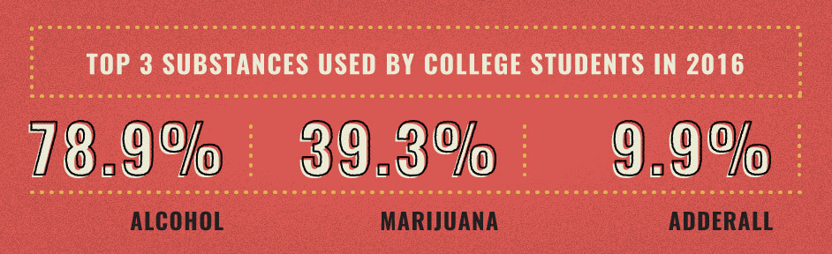
Prevalence of Substance Use and Abuse Among Young Adults
79.9% alcohol, 39.3% marijuana and 9.9% Adderall are consumed by young adults (Montgomery & Mantey, 2018).
Around 7 million young adults battle illicit drug disorders.
Binges trigger substance abuse for more than 90 percent for young adults in the United States.
49 percent of young adults in the 12th grade admit to have consumed substances at least once per month.
Notes:
Substances abuse among the young adults have continued to increase as a result of media pressure and peer pressure (Montgomery & Mantey, 2018). Parties trigger the consumption of substances since young adults are unable to handle peer pressure. It is imperative for adolescents to understand the effects of abusing substances.

Slide 7
Prevalence of Substance Use and Abuse Among Young Adults (Cont..)
11% of young adults abuse substances via injections (Montgomery & Mantey, 2018).
There are six deaths per day related to alcoholism.
15 million of young adults live with alcohol disorders.
Social media platforms should be used to create awareness among young adults.
Notes:
The prevalence of substance use and abuse among teens have continued to increase as a result of media and peer pressure (Montgomery & Mantey, 2018). Social media platforms can be used to increase awareness among the teens. As a result, alcohol disorders will be significantly be reduced.

Slide 8

Roles of a Health Care Practitioner/Advocate in Addressing the Issue
Provision of medications
Conducting screening questions (Vaughn et al., 2018).
Providing counselling and guidelines
Educating young adults on how to manage addiction
Notes:
The healthcare practitioner has a vital role as far as abusing substances among young adults (Vaughn et al., 2018). Healthcare givers are expected to provide treatment, counselling and conducting screening questions. Healthcare givers should be able to reduce the prevalence of substance abuse among the young adults.

Slide 9

Ways to Identify and Address Substance Use and Drug Abuse
Substance abusers are look dizzy and fatigued.
They also suffer from disorders (Vaughn et al., 2018).
Substance abusers hardly interact with others.
They like staying alone and in isolation.
Notes:
Young adults who abuse substances are likely to suffer from some common signs. According to Vaughn et al. (2018), conditions such as dizziness, fatigue, isolation govern substance abusers. Young adults are unable to live and enjoy their social life, especially at school and at home.

Slide 10

Ways to Identify and Address Substance Use and Drug Abuse (Cont..)
Moral guidance is vital.
Awareness on the effects of substances is important (Montgomery & Mantey, 2018).
Substance abusers should join rehabilitation and collection centres.
Physical and mental therapies are also vital.
Notes:
Providing moral guidance is vital in addressing or reducing cases related to substance use and abuse among young adult substances. It is also important to create awareness, especially on the effects of substance use and drug abuse (Montgomery & Mantey, 2018). The providence of mental and physical therapies are also essential especially to abusers who have severe conditions.

Slide 11
Presentation of an Activity or Project for the Audience to Engage
The prevalence of substance use and drug abuse should be reduced. In this case, the audience is formed by the students. Students group themselves in groups of ten with an aim to create awareness regarding this issue. Awareness should be done in learning institutions since this will target young adults. In addition, this group will be in a position to educate fellow students on the causes, effects and solutions that can be used to address it. For that reason, this will place the students in a pole position to understand the effects of abusing substance and drug abuse in society.

Slide 12

Help and Support Resources Young Substance Use and Abuse
Helplines
Advocacy opportunities (Montgomery & Mantey, 2018).
Role models
Rehabilitation centres
Notes:
Helplines are vital since young adults can easily use them to call after conditions become severe. Nurses should also act as advocates, and as such, this will reduce the prevalence of the issue. Role models as well as rehabilitation centres in society are also important resources that can be used in addressing the issue.

Slide 13
Conclusion
The creation of awareness is vital to address substance use and drug abuse.
Substance use and drug abuse causes disorders and severe effects.
Society ought to discourage the abuse of drugs and substances.
Young adults will be able to continue with their education.
Notes:
Substance use and drug abuse is attributed to mental disorders as well as depression, which can affect their development as well as academics. In addition, it is important for society to educate young adults against substances to promote their health conditions as well as their development.

Slide 14
References
Hussong, A. M., & Smith, R. K. (2018). Parent-Based Models of Adolescent Substance Use. Handbook of Adolescent Development Research and Its Impact on Global Policy.
Montgomery, L., & Mantey, D. (2018). Racial/ethnic differences in prevalence and correlates of blunt smoking among adolescents. Journal of psychoactive drugs, 50(3), 195-205.
Vaughn, M. G., AbiNader, M. A., Salas-Wright, C. P., Oh, S., & Holzer, K. J. (2018). Declining trends in drug dealing among adolescents in the United States. Addictive behaviors, 84, 106-109.

